Slide 1

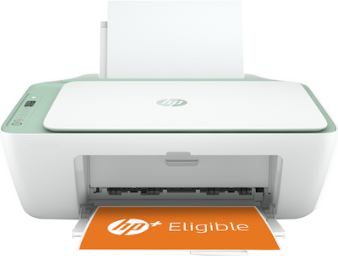

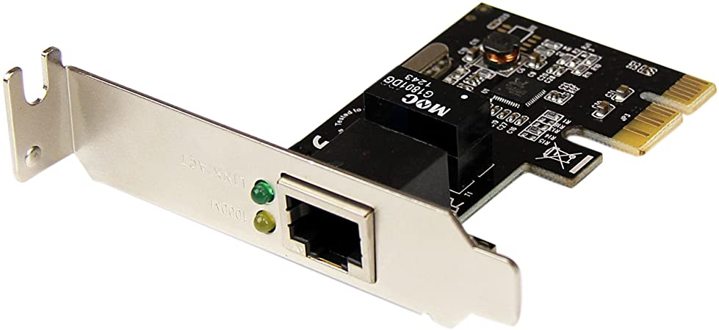
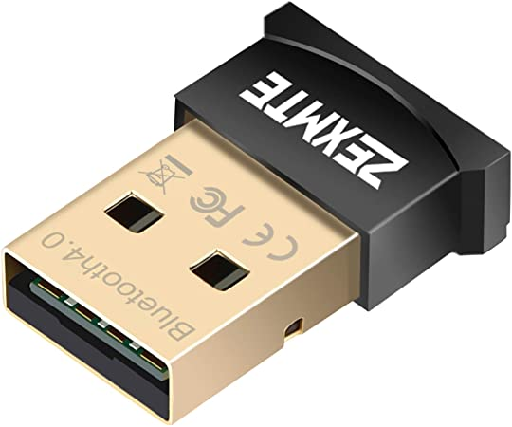
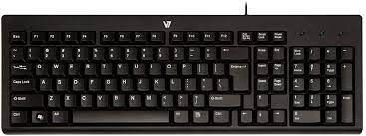
Input/Output
Yuemin Ding
Tecnun, University of Navarra
Fall, 2021

Slide 2
Outline
External devices and I/O module
Input/Output techniques
Programmed I/O
Interrupt-driven I/O
Direct Memory Access
Direct cache access and I/O channel

Slide 3
External Devices
External devices can be classified into three categories:
  Human readable
    e.g. monitor, printer
  Machine readable
    e.g. keyboard, mouse, sensors
  Communication
    e.g. Network Interface Card (NIC), WiFi/bluetooth module

Slide 4
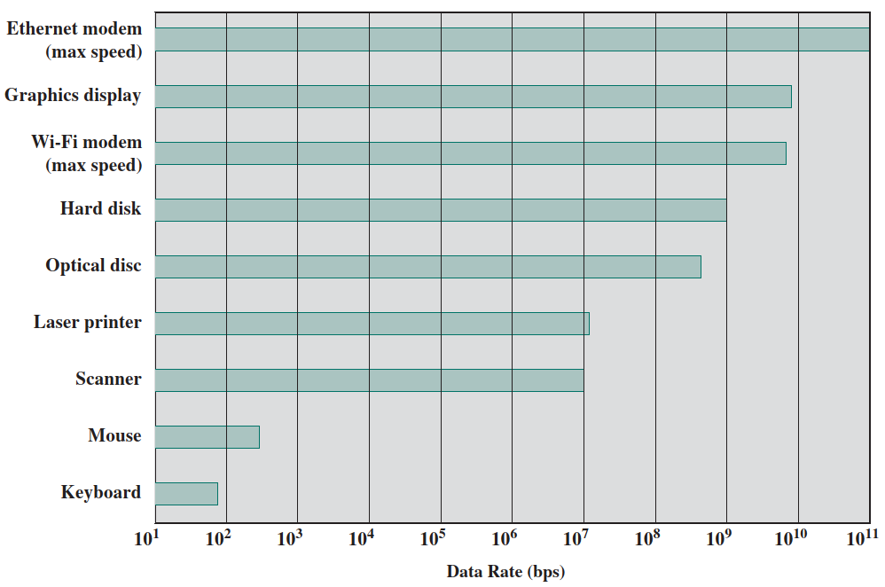
Input/Output Problems
Wide variety of peripherals
  Delivering different amounts of data
  At different speeds
  In different formats
Most are slower than CPU/RAM, but some can be faster

Slide 5
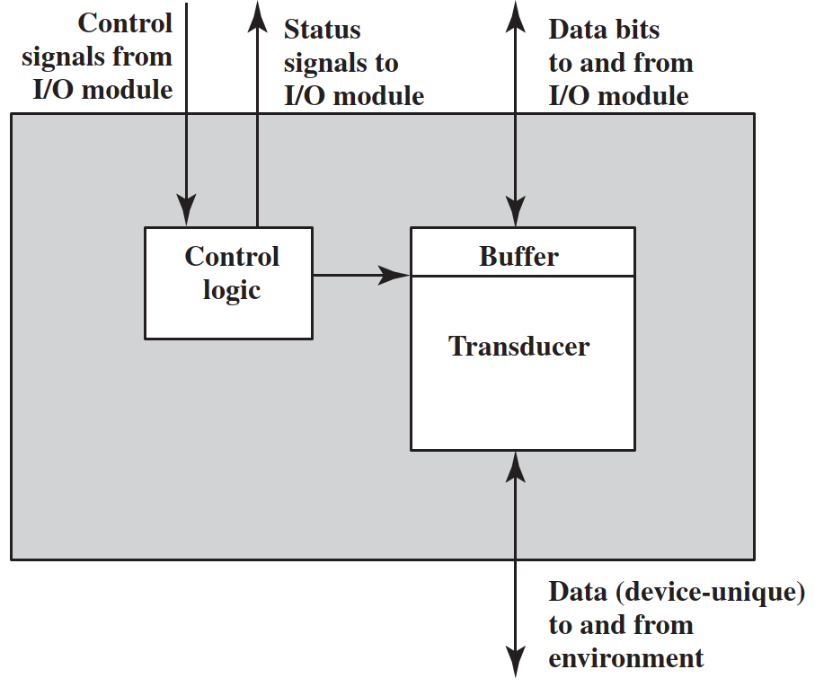
External Device Block Diagram
The interface of external device includes:
Control signals → determines the function that the device will perform, e.g. read/write
Status signals → indicates the state of the device, e.g. busy/idle
Data bits→ actual data to be exchanged with I/O module
Data to and from environment
Interface
Computer
I/O device

Slide 6
External Device Block Diagram
Inside the external device, there are:
Control logic → controls the device’s operation in response to control signals
Transducer → converts data from electrical to other forms or vice versa
Buffer → temporarily hold data being transferred between I/O module and the device.
Interface
Computer
I/O device

Slide 7
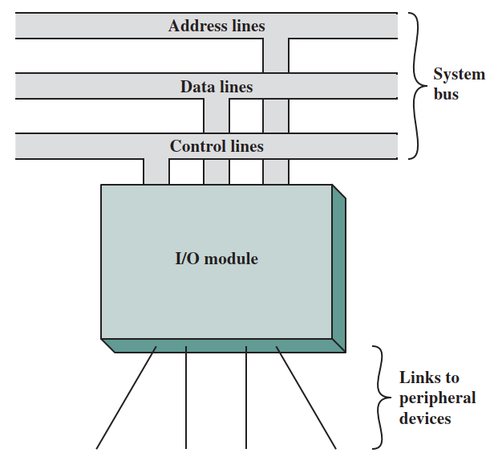
Input/Output Module
To handle the wide variety of peripherals and operation details, I/O modules are used
I/O modules provides:
Interface to the processor and memory
Interface to one or more peripheral devices
CPU+RAM
Computer
I/O device
Device 1
Device 2
Device 3
Device 4

Slide 8
I/O Module
I/O module functions:
Control & Timing
→ bridging between the processor and I/O devices
CPU Communication
→ command decoding, status reporting, address recognition, data transferring
Device Communication
→ data, status, control signal
Data Buffering
→ temporarily stores data
Error Detection
→report I/O device error
CPU+RAM
Computer
I/O device
Device 1
Device 2
Device 3
Device 4

Slide 9
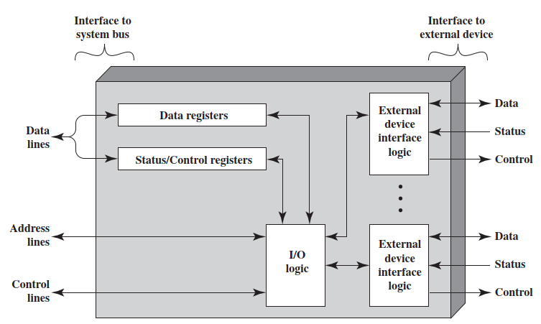
I/O Module structure
The module connects to the rest of the computer through a set of signal lines
Data transferred to and from the module are buffered in one or more data registers
The logic within the module interacts with the processor and the I/O devices
I/O devices
CPU+RAM
I/O module

Slide 10
I/O Module Advantages
It takes on most of the detailed processing burden, presenting a high-level interface to the processor
I/O module hides a variety of device properties to CPU
Allow the processor to view a wide range of devices in a simple way.
I/O devices
CPU+RAM
I/O module

Slide 11
I/O Module Advantages
CPU issues address
  Identifies module & device
CPU issues command
  Control - telling module what to do
    e.g. spin up disk
  Test - check status
    e.g. power up? Error?
  Read/Write
    Module transfers data via buffer from/to device

Slide 12
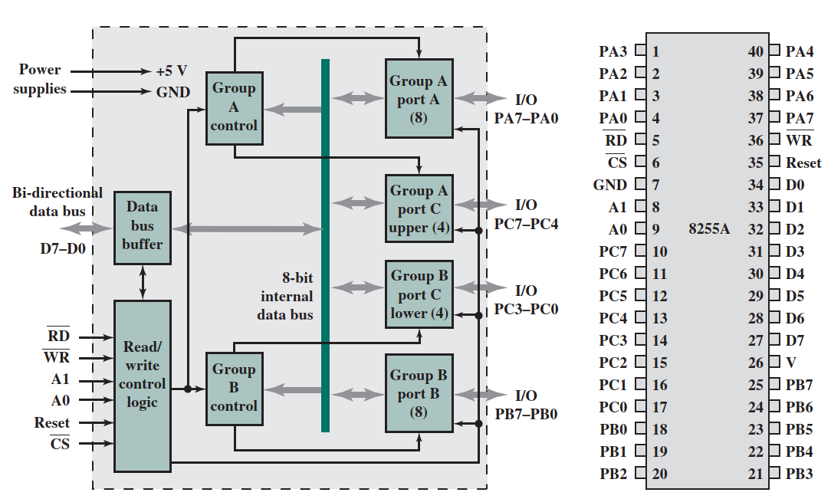
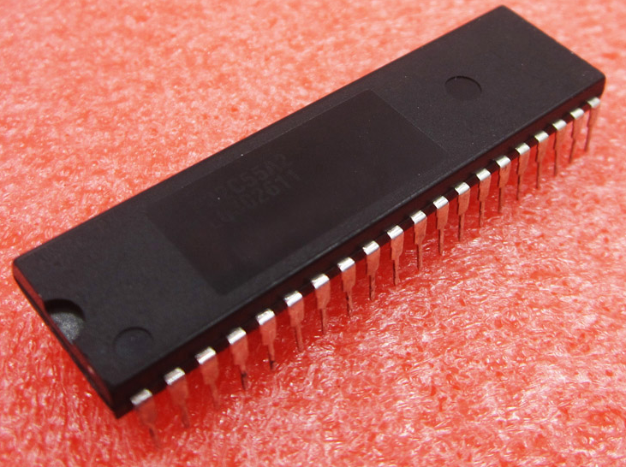
Intel 82C55A I/O module
The 82C55A is a single-chip, general-purpose I/O module
It has been used as controller of I/O devices for microprocessors and in embedded systems

Slide 13
Intel 82C55A I/O module
The inner block includes buffer/registers, I/O logic, external interface, and connections
I/O module block diagram
82C55A I/O module

Slide 14
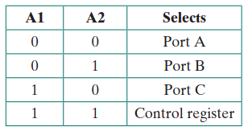
Intel 82C55A I/O module
Pin layout of 82C55A:
D0-D7: data I/O lines to exchange data with CPU
CS(chip select): low → selected for further operation by CPU
RD(read input): low → CPU reads data from 82C55A
WR(write input): low → CPU writes data to 82C55A
Reset: high → 82C55A chip
PA0-7, PB0-7, PC0-7: data I/O lines to exchange data with peripherals
A0, A1: address lines to select which port/registers to write to or read from
A0
A1

Slide 15
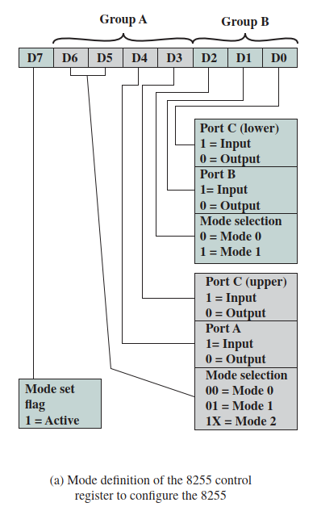
Intel 82C55A I/O module
The control word is used to configure the operating mode of the 24 I/O lines:
Mode 0: Port A, B, C are set as basic I/O mode
Mode 1: Port A, B are either input or output. Port C serves as the control lines (upper 4 for PA, lower 4 for PB)
Mode 2: bidirectional mode (Port A/B is input, the other is output, Port C is control lines)

Slide 16
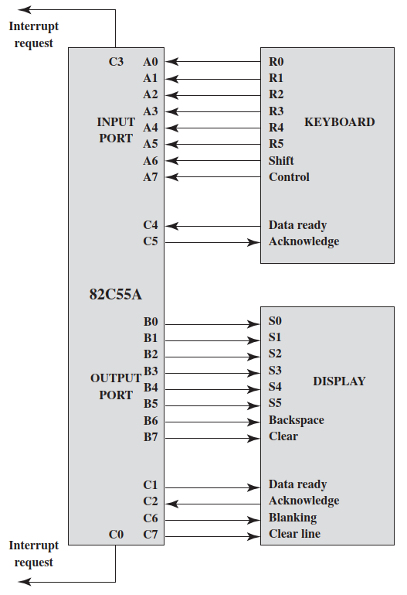
Keyboard/Display Interfaces to 82C55A
An example of keyboard and display:
A6, A7 indicates shift and control button of keyboard
C4, C5 are handshaking lines with keyboard
C0, C3 are used as interrupt lines for keyboard and display

Slide 17
Outline
External devices and I/O module
Input/Output techniques
Programmed I/O
Interrupt-driven I/O
Direct Memory Access
Direct cache access and I/O channel

Slide 18
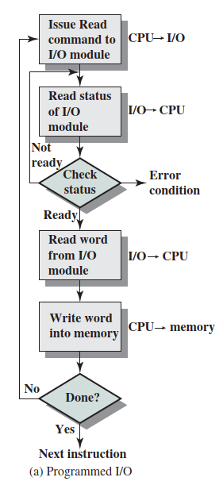
Programmed I/O
CPU requests I/O operation
I/O module performs operation and sets status bits
CPU checks status bits periodically
I/O module does not inform CPU directly
I/O module does not interrupt CPU
CPU may wait or come back later

Slide 19
Programmed I/O
CPU has direct control over I/O module:
  Sensing status
  Read/write commands
  Transferring data
CPU waits for I/O module to complete operation
Wastes CPU time

Slide 20
Outline
External devices and I/O module
Input/Output techniques
Programmed I/O
Interrupt-driven I/O
Direct Memory Access
Direct cache access and I/O channel

Slide 21
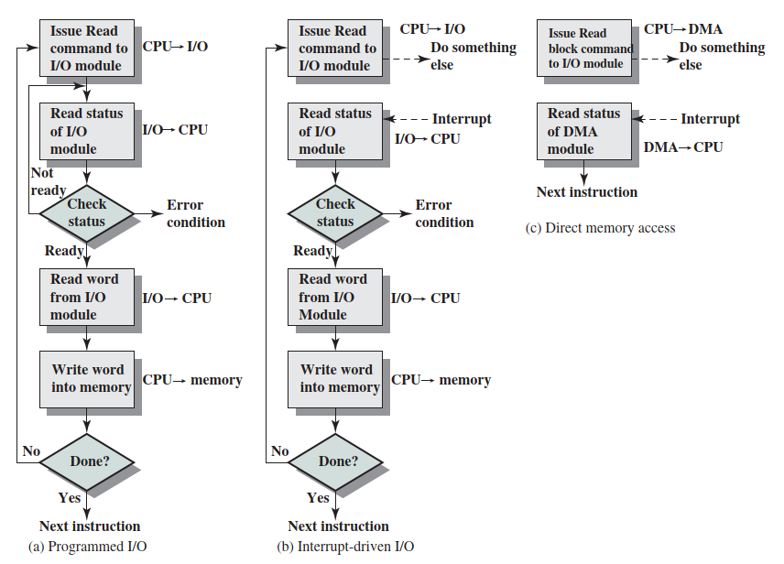
Interrupt Driven I/O
CPU issues read command
I/O module gets data from peripheral whilst CPU does other work
I/O module interrupts CPU
CPU requests data after the interrupt
I/O module transfers data

Slide 22
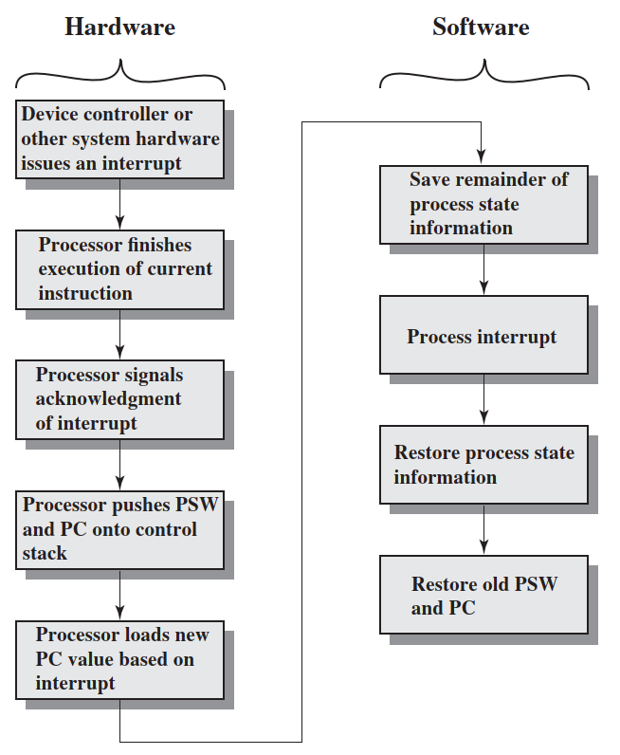
Simple Interrupt Processing
Read word and write to memory
Q1: why is this necessary?
Q2: where does the new PC point to?
Notes:
PSW – Program status word

Slide 23
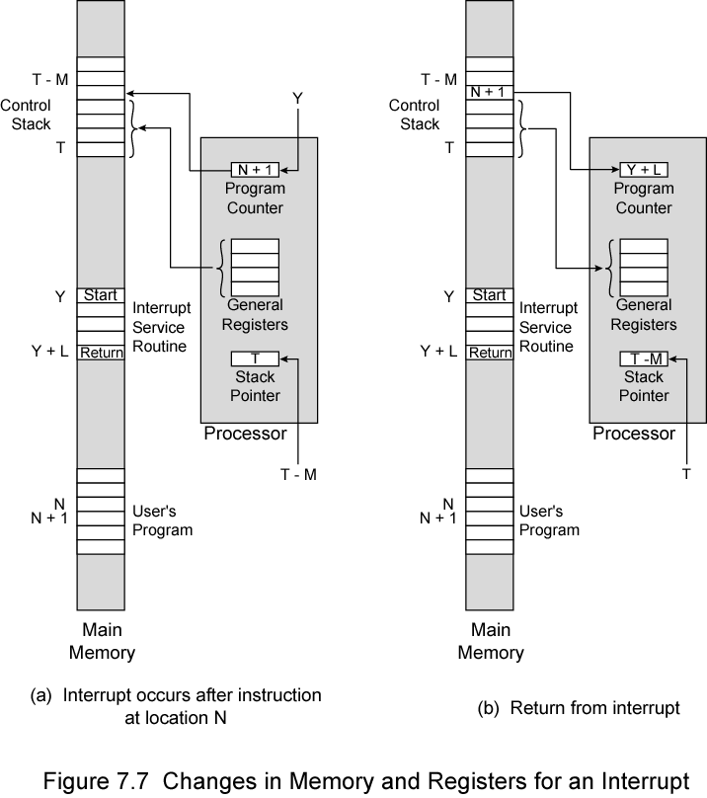
Changes in Memory and Registers for an Interrupt
T-M
T
T
T-M
Interrupt

Slide 24
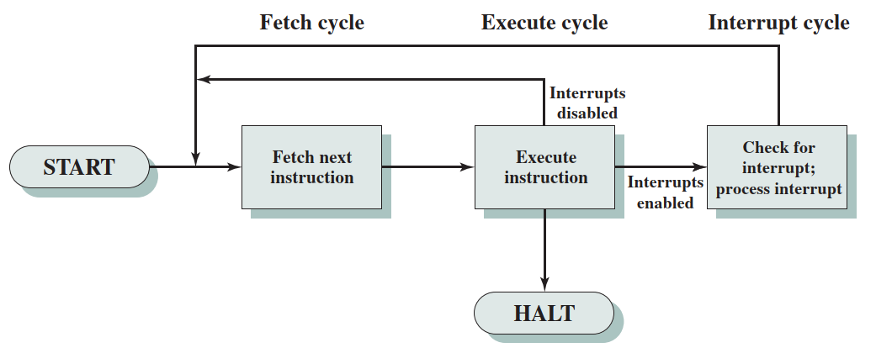
CPU Viewpoint for Interrupt-driven I/O
Issue read command
Do other work
Check for interrupt at end of each instruction cycle
If interrupted:
  Save context (registers, such as PC value)
  Process interrupt
    Fetch data & store
  Restore the saved context
Otherwise, continue other work

Slide 25
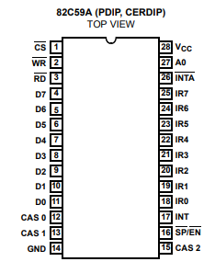
Example – 82C59A interrupt controller
The Intel 80386 CPU has one interrupt line
To allow the 80386 to handle a variety of devices, the 82C59A interrupt controller is used.
82C59A has 8 interrupt lines:
Accepts interrupts from I/O device
Determines priority of multiple interrupts
Signals the interrupt to the CPU
Wait for CPU acknowledges
Puts correct vector on data bus
CPU processes interrupt
Interrupts signals
I/O 1
I/O 0
CPU

Slide 26
Exercise 1
How to use multiple 82C59A to support more than 8 interrupts (e.g. 15 or 64)?
Interrupts signals
I/O 1
I/O 0
CPU

Slide 27
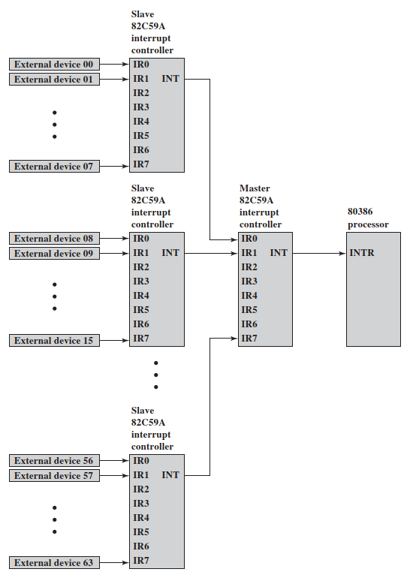
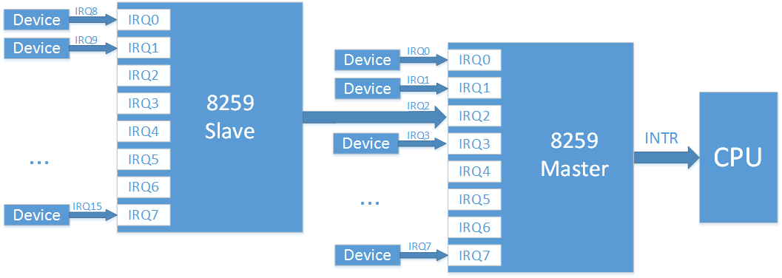
Example – 82C59A interrupt controller
15 interrupts
64 interrupts

Slide 28
Other Ways to Identify Interrupting Module
Software poll
  CPU asks each I/O module in turn
  Processing speed is slow
Daisy Chain or Hardware poll
  Interrupt Acknowledge sent down a chain
  Module responsible places vector on bus
  CPU uses vector to identify handler routine
Bus Arbitration
  Module must gain control of the bus before it can raise interrupt
  Only one module can raise the line at a time
Daisy chain

Slide 29
Outline
External devices and I/O module
Input/Output techniques
Programmed I/O
Interrupt-driven I/O
Direct Memory Access
Direct cache access and I/O channel

Slide 30
Drawbacks of Programmed and Interrupt-Driven I/O
Interrupt driven and programmed I/O still require active CPU intervention
  Transfer rate is limited by the I/O device
  CPU is tied up in managing an I/O transfer
When large volumes of data are to be moved (e.g. printer), a more efficient technique is required
Direct memory access (DMA)

Slide 31
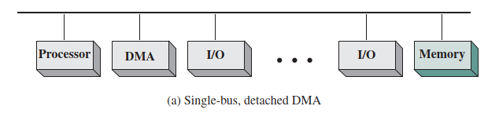
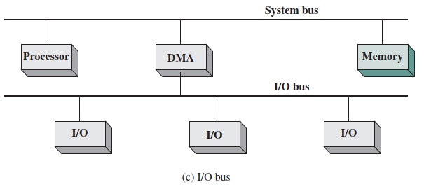
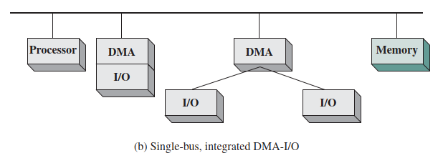
Direct memory access (DMA)
DMA module is an additional module on bus
DMA module mimics the processor and takes over control of I/O devices from the processor
DMA controller takes over from CPU for I/O devices
The processor is freed from interacting with low speed I/O devices

Slide 32
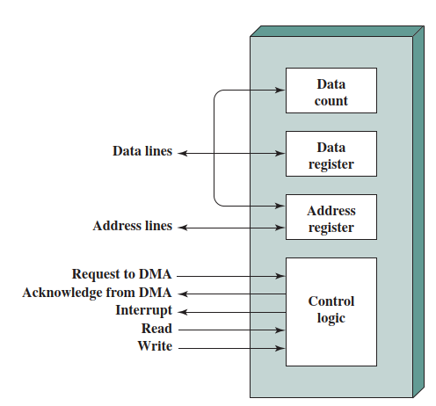
DMA Operation
CPU tells DMA controller:
  Read/Write
  Device address
  Starting address of memory block for data
  Amount of data to be transferred
CPU carries on with other work
DMA controller deals with transfer
DMA controller sends interrupt when finished

Slide 33
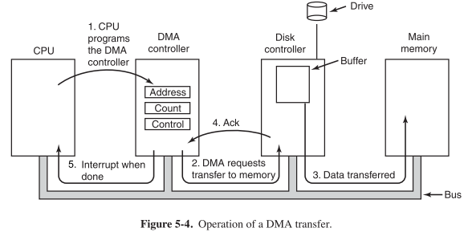
DMA Operation
Q: What if both CPU and DMA controller wants to access the main memory?

Slide 34
DMA Transfer Cycle Stealing
The processor and DMA controller shares the system bus
DMA controller takes over bus to transfer a word of data
However, this is not an interrupt
  CPU does not switch context
CPU suspended just before it accesses bus
  i.e. before an operand or data fetch or a data write
Slows down CPU but not as much as CPU doing transfer

Slide 35
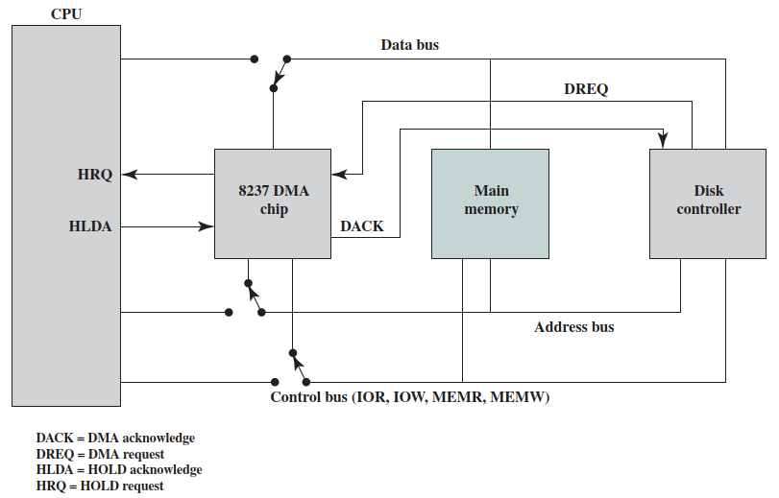
Intel 8237A DMA Controller
When DMA module needs buses it sends HOLD signal to processor
CPU responds HLDA (hold acknowledge)
  DMA module can use buses
E.g. transfer data from memory to disk
  Device requests service of DMA by pulling DREQ (DMA request) high
  DMA puts high on HRQ (hold request)
An example: transfer data from memory to disk
I/O Read (IOR)
I/O Write (IOW)
Memory Read (MEMR)
Memory Write (MEMW)

Slide 36
Intel 8237A DMA Controller
  CPU finishes present bus cycle (not necessarily present instruction) and puts high on HDLA (hold acknowledge). HOLD remains active for duration of DMA
  DMA activates DACK (DMA acknowledge), telling device to start transfer
  DMA starts transfer by putting address of first byte on address bus and activating MEMR; it then activates IOW to write to peripheral.
An example: transfer data from memory to disk
I/O Read (IOR)
I/O Write (IOW)
Memory Read (MEMR)
Memory Write (MEMW)

Slide 37
Intel 8237A DMA Controller
  DMA decrements counter and increments address pointer. Repeat until count reaches zero.
  DMA deactivates HRQ, giving bus back to CPU
I/O Read (IOR)
I/O Write (IOW)
Memory Read (MEMR)
Memory Write (MEMW)
An example: transfer data from memory to disk

Slide 38
Summary of I/O Techniques
Programmed I/O
Interrupt driven I/O
Direct Memory Access (DMA)

Slide 39
Outline
External devices and I/O module
Input/Output techniques
Programmed I/O
Interrupt-driven I/O
Direct Memory Access
Direct cache access and I/O channel

Slide 40
Direct Cache Access (DCA)
DMA has proved an effective means of enhancing performance of I/O devices
However, recent years, the network I/O has dramatically increased to 10/100G-bps, which is faster than the main memory
Direct cache access (DCA) is proposed, in which data are directly write to/read from the last-level cache
DCA has been used on Intel Xeon processors designed for network servers

Slide 41
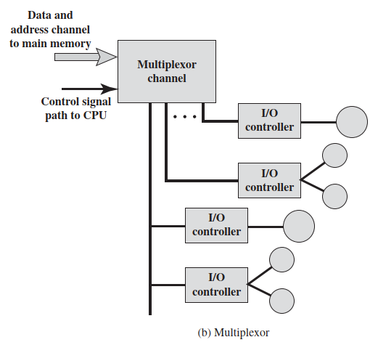
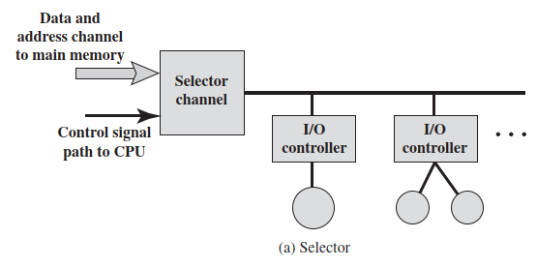
I/O Channels and Processors
The I/O channel represents an extension of the DMA concept
The difference is that an I/O channel has the ability to execute I/O instructions.
The CPU initiates an I/O transfer by instructing the I/O channel to execute a program in memory.

Slide 42
Thank you!
Q&A

